Slide 1
Paddy Disease Detection
Name: Darneshwar, Keerthana, Preethi
Roll No: CSE21309,49,65
Photo
Github URL: https://github.com/preethi5SE/dlcv.git
< Purpose (Like Review on…) >
Collabrator Details:
Advisor / Course Instructor details

Slide 2
Agenda
Introduction
Literature survey
Challenges
Dataset description
Methodology
Data analysis
ML model
DL model
Explainable AI
Conclusion
Future Enhancement

Slide 3
Contributions
Roll.No | Name | Contribution (Architecture Name) | Uniqueness in Contribution
CB.EN.U4CSE21309 | DARNESHWAR
CB.EN.U4CSE21349 | KEERTHANA
CB.EN.U4CSE21365 | PREETHI

Slide 4
Problem Statement
Develop advanced machine learning and deep learning models to accurately classify diseases in paddy crops from images. Leveraging state-of-the-art computer vision techniques, the project aims to enable early detection and diagnosis, improving crop management

Slide 5
List of Benchmark datasets
https://www.kaggle.com/datasets/imbikramsaha/paddy-doctor
Classes['bacterial_leaf_blight', 'bacterial_leaf_streak', 'bacterial_panicle_blight', 'blast', 'brown_spot', 'dead_heart', 'downy_mildew', 'hispa', 'normal', 'tungro’]
https://www.kaggle.com/datasets/badhon7432/paddyleafdiseaseuci/data
['Brown spot', 'Leaf smut', 'Bacterial leaf blight’]

Slide 6
Analytical Questions
Simple
1.Which paddy disease is most frequently misclassified by the model?
2. What is the average time taken by the model to classify an image?
Medium
3. How does the model's performance vary across different environmental conditions (e.g., lighting, background, etc.) in the images?
4. How does the model perform when trained and tested on images from different geographic regions?
Difficult
5.Can the model identify multiple diseases in a single image, and how accurate is this multi-label classification?
6. How well does the model perform in detecting early-stage symptoms of paddy diseases compared to advanced-stage symptoms?

Slide 7
Research Questions 28.8.24
Identify the model used for classifying the disease
What types of image used -> RGB/Grayscale
Existing model and the implementation going to be done

Slide 8
Introduction
Provide an introduction to the project.
Effective management of paddy crops is crucial for ensuring high yields and quality. This project focuses on developing a system for detecting diseases in paddy plants using advanced technologies. By leveraging machine learning , Deep Learning, explainable AI and image analysis, our goal is to create a reliable tool that helps farmers identify and address diseases early, ultimately improving crop health and productivity.
Give some statistical inference stating why this project is necessary.
1.Economic Impact of Paddy Farming:
Paddy rice is a staple food for more than half of the world's population, especially in Asia. According to the Food and Agriculture Organization (FAO), rice accounts for 20% of global calorie intake. Improving the efficiency and productivity of paddy farming can have a significant impact on global food security.

Slide 9
2. Prevalence of Crop Diseases:
Studies show that crop diseases can lead to up to 30% yield loss in paddy fields if not managed properly. The FAO reports that diseases and pests are major threats to
paddy crops, impacting not just the quantity but also the quality of the yield. Early detection is crucial for minimizing damage and losses.
3. Current Challenges in Detection:
Traditional methods of paddy disease detection often involve manual inspection by experts, which is time-consuming and prone to human error. According to research, manual inspection can have detection accuracies as low as 60-70%, while deep learning models can achieve accuracies above 90% in some cases.
Give Social relevance to the project.
This project enhances food security by improving paddy crop health, directly impacting millions of farmers and consumers. Early disease detection boosts yields, reduces economic losses, and supports sustainable agriculture, contributing to community well-being and resilience in rice-dependent regions.

Slide 10
List of Products similar to this project
Product Name | URL | Features
Paddy Doctor | https://paddydoc.github.io/ | Dual-Spectrum Detection
AppPADI | https://github.com/rifqinvnd/Rice-Disease-Prediction-Application | Integrated Disease Management
Rice Doctor | https://www.irri.org/rice-doctor | wide range of diagnostic options (80 diseases)
riceXpert | http://www.ricexpert.in/ | Digital tool designed for monitoring and managing paddy crops
Paddy Inspector | https://github.com/paddydoc/paddydoc.github.io | automated identification of diseases and pests in paddy

Slide 11
List of Research Labs
Name of the lab | URL | Name of the Professor | Institute | Country
Agricultural Innovation and advanced learning Lab | https://research.vit.ac.in/researcher/ramesh-kumar-s-1 | Prof.Ramesh Kumar S | Vellore Institute of technology | India
Lingnan Guangdong Laboratory of Modern Agriculture | https://www.nature.com/nature-index/institution-outputs/china/guangdong-laboratory-for-lingnan-modern-agriculture-scau/5e8a8b7a24d592033f6894f9 | Prof.Long Qi | South China Agricultural University, | China
Jilin Precision Agriculture and Big Data Engineering Research Center, Changchun | https://ieeexplore.ieee.org/author/38194560500 | Prof. Helong Yu | College of Information Technology, Jilin Agricultural University | China

Slide 12
Literature Survey
All survey must be organized under different sections. For example(Datasets, Algorithms)
Minimum 15 papers.
Should have papers from 2023, 2024.
Provide the quantitative metrics for each paper referred.
5 EACH X 3 = 15

Slide 13
1. A Novel Fine-Tuned Deep-Learning-Based Multi-Class Classifier for Severity of Paddy Leaf Diseases
Authors: Shweta Lamba, Vinay Kukreja, et al.
Published In: Frontiers in Plant Science, 2023
Overview: This paper presents a hybrid approach that combines Convolutional Neural Networks (CNN) and Support Vector Machines (SVM) to classify the severity of paddy leaf diseases. The dataset comprises 4,068 images sourced from various online repositories.
Methodology: The dataset was augmented using Generative Adversarial Networks (GAN) to improve model training. The model categorizes disease severity into four levels: mild, moderate, severe, and profound.
Results: The model achieved an accuracy of 98.43% in predicting the type and intensity of diseases such as bacterial blight, blast, and leaf smut, demonstrating its effectiveness in practical applications.
2. Rice Plant Disease Diagnosing Using Machine Learning Techniques: A Comprehensive Review
Overview: This review article surveys multiple machine learning techniques applied to the diagnosis of rice plant diseases, with a specific focus on CNNs.
Findings: The review discusses the effectiveness and limitations of various approaches, providing a comprehensive understanding of the current state of research in rice disease detection. It highlights the need for improved algorithms and datasets to enhance diagnostic accuracy.

Slide 14
3. Stacking-Based and Improved Convolutional Neural Network: A New Approach in Rice Leaf Disease Identification
Overview: This study introduces a stacking ensemble model that integrates multiple CNN architectures (including improved AlexNet, GoogLeNet, ResNet50, and MobileNetV3) along with SVM as a sub-learner.
Methodology: The model leverages an attention mechanism to focus on disease-specific features, improving the classification of rice leaf diseases.
Results: The proposed model achieved a remarkable accuracy of 99.69%, showcasing its potential for effective disease identification in agricultural settings.
4. GoogLeNet Based on Residual Network and Attention Mechanism Identification of Rice Leaf Diseases
Overview: This paper explores a modified GoogLeNet architecture that incorporates residual networks and attention mechanisms to enhance the detection of rice leaf diseases.
Findings: The integration of these advanced techniques aims to improve the model's focus on relevant features, thereby increasing the accuracy of disease classification.

Slide 15
Detection and Classification of Paddy Leaf Diseases Using Deep Learning (CNN)
Authors: S. Maheswaran, S. Sathesh, P. Rithika, I. Mohammed Shafiq, S. Nandita
Published: SpringerLink
Summary: This paper presents a deep learning approach using Convolutional Neural Networks (CNN) to detect and classify diseases in paddy leaves. The study demonstrates high accuracy in identifying multiple types of diseases, making it a valuable tool for agricultural management.
A Survey on Paddy Crop Disease Detection Using Machine Learning and Artificial Intelligence Models
Authors: N. Chakraborty, R. Nanda, K. Das
Published: SpringerLink
Summary: This paper surveys various machine learning and AI models used for detecting diseases in paddy crops. It highlights the advantages of using these advanced techniques over traditional methods, offering insights into future research directions.
Seasonal Crops Disease Prediction and Classification Using Deep Convolutional Encoder Network
Authors: A. Khamparia, G. Saini, D. Gupta, A. Khanna, S. Tiwari, V.H.C. de Albuquerque
Published: Circuits Systems Signal Processing
Summary: This paper discusses a deep convolutional encoder network designed for predicting and classifying diseases in seasonal crops, including paddy. The model shows significant promise in real-time disease monitoring and prevention.

Slide 16
Paddy Crop Disease Prediction—A Transfer Learning Technique
Authors: S.S. Rautaray, M. Pandey, M.K. Gourisaria, R. Sharma
Published: International Journal of Recent Technology and Engineering
Summary: The authors explore the use of transfer learning in predicting paddy crop diseases. The study emphasizes the efficiency of transfer learning models in achieving high accuracy with limited data, making it ideal for resource-constrained environments.
Identification and Recognition of Paddy Diseases and Pests Using Convolutional Neural Networks
Authors: C.R. Rahman, P.S. Arko, M.E. Ali
Published: Biosystems Engineering
Summary: This paper investigates the application of CNNs in identifying and recognizing diseases and pests in paddy fields. The research focuses on improving the robustness of detection systems under varying environmental conditions.

Slide 17
Challenges
Bring the research gap identified from the survey.

Slide 18
Problem Statement
Given a dataset of MNIST, the proposed model will do the following.
Understand the characteristics of MNIST, and identify the insights to develop the model with ensured quality.
To utilize conventional machine learning algorithms such as Support Vector Machines, K-Nearest Neighbors, and Random Forests to classify handwritten digits, and conduct a comparative analysis to evaluate their performance.
Apply deep learning techniques, such as convolutional neural networks (CNNs) and variants of transfer learning techniques to classify handwritten digits, and conduct a comparative assessment to evaluate their effectiveness in handling the MNIST dataset.
Incorporate eXplainable Artificial Intelligence (XAI) methodologies like SHAP (SHapley Additive exPlanations), LIME (Local Interpretable Model-agnostic Explanations), to offer insights into model predictions and improve interpretability.

Slide 19
Motivation
The proposed solution facilitates early disease detection in paddy crops, thereby reducing losses and improving food security.
Dataset : High-quality, annotated datasets with images from diverse conditions and early disease stages are crucial for training robust machine learning models.
Algorithms: machine learning techniques, such as CNNs and transfer learning, improve classification accuracy by leveraging pre-trained models and extracting relevant features, potentially integrating temporal data for enhanced detection.
Economic Impact :Effective disease detection ensures stable paddy production, contributing to global food security and reducing economic losses for farmers by minimizing crop loss and pesticide use, thus improving overall agricultural productivity.

Slide 20
Dataset Description
Description of the dataset (an overview or plan on dataset to be used for the project).
Suggest how a custom dataset can be created for your project.
Citations related to the dataset (if available; benchmark data preferably do) and justify the chosen dataset.
Relate your dataset study to the problem statement and motivation and specify how your dataset can be the best one for the proposed solution (In other words, describe how the collected or acquired data is useful for the problem being addressed).

Slide 21
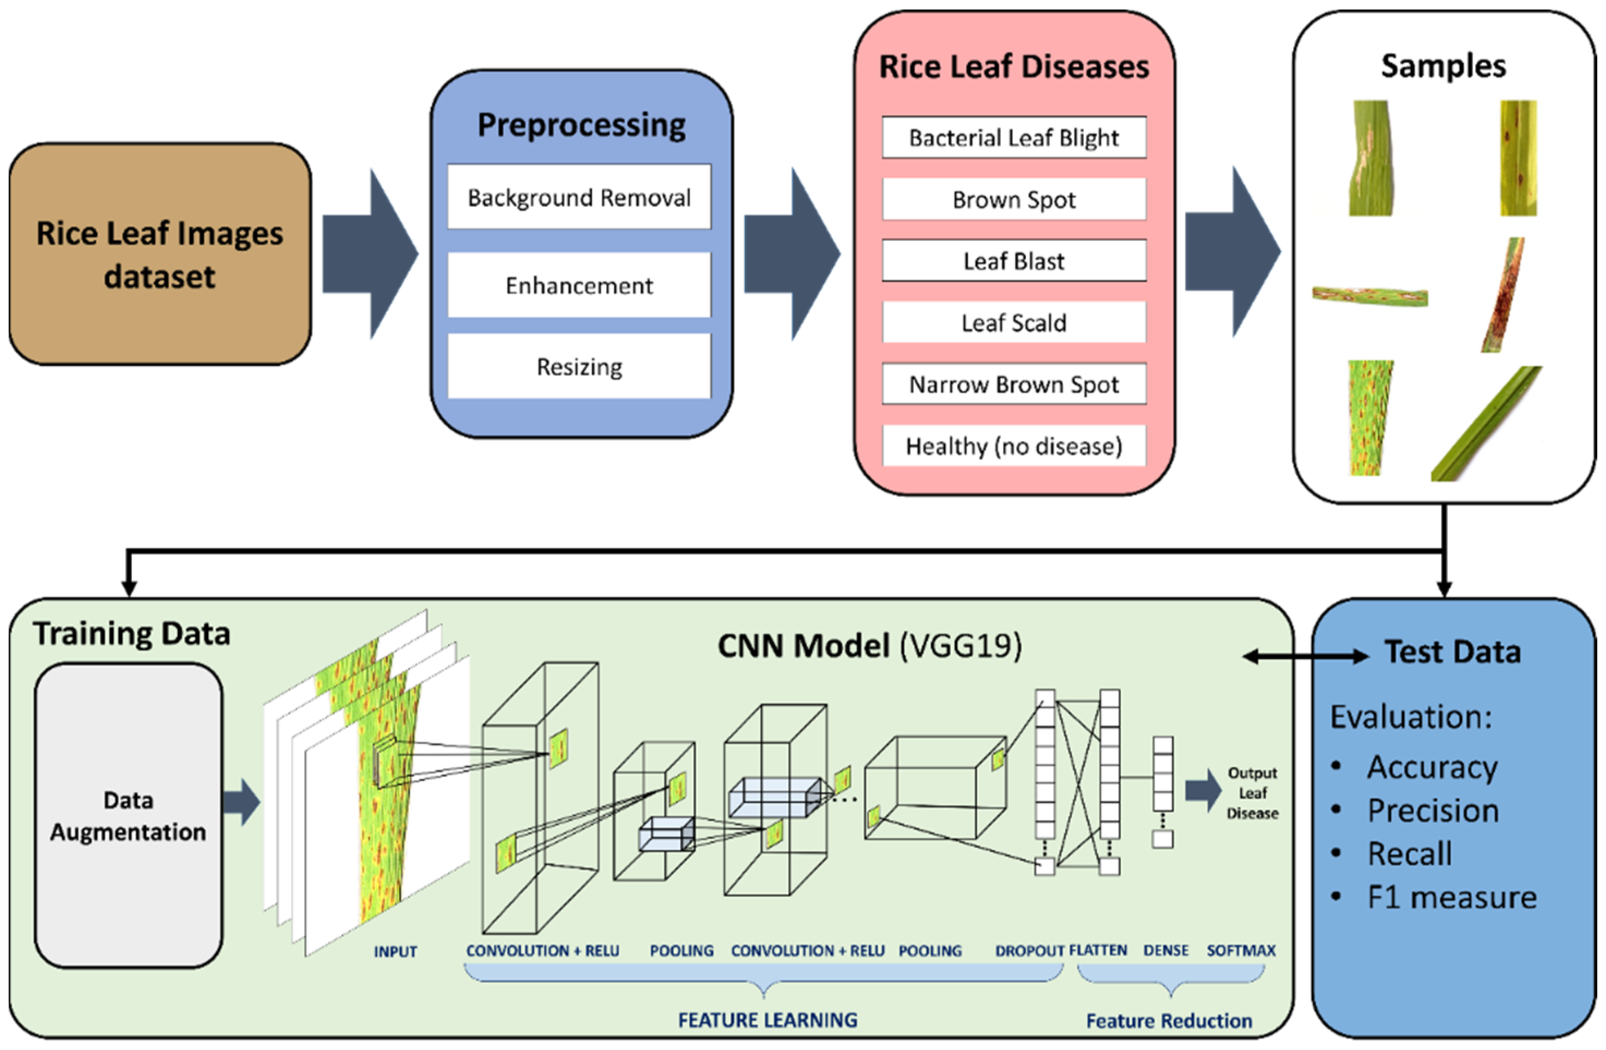
Block Diagram

Slide 22
Methodology
Section (i): Data Analysis
Section (ii): Machine Learning Model
Section (iii): Deep Learning Model
Section (iv): Explainable AI

Slide 23
Data analysis
Advantages:
Insight Generation: Helps in understanding patterns, trends, and anomalies in the data.
Decision Making: Facilitates data-driven decision-making by providing quantitative evidence.
Simplifies Complex Data: Breaks down complex datasets into understandable summaries and visualizations.
Problem Identification: Identifies issues and areas for improvement in data collection and processes.
Limitations:
Data Quality Dependence: The accuracy of analysis is highly dependent on the quality of the data.
Time-Consuming: Can be time-consuming, especially with large datasets.
Requires Expertise: Needs skilled analysts to interpret data correctly.
Static Insights: Provides insights based on historical data, not necessarily predictive.

Slide 24
Machine Learning model
Advantages:
Predictive Power: Can predict future trends and outcomes based on historical data.
Automation: Automates decision-making processes, reducing the need for human intervention.
Adaptability: Can adapt and improve over time with more data
Scalability: Applicable to various domains and can handle large datasets efficiently.
Limitations:
Data Dependency: Requires large amounts of high-quality data for accurate predictions.
Complexity: Models can be complex and difficult to understand or interpret.
Overfitting: Risk of overfitting to training data, leading to poor generalization.
Resource Intensive: Can be computationally expensive and require significant resources.

Slide 25
Deep Learning model
Advantages
High Accuracy: Often achieves higher accuracy than traditional machine learning models, especially in image and speech recognition tasks.
Feature Extraction: Automatically extracts relevant features from raw data, reducing the need for manual feature engineering.
Complex Data Handling: Excels at handling complex data types, such as images, audio, and text.
Scalability: Can process and learn from large-scale datasets.
Limitations
Data Hungry: Requires vast amounts of labeled data for training.
Computational Cost: Extremely resource-intensive, needing powerful GPUs and significant computational power.
Black Box Nature: Often criticized for being opaque and difficult to interpret.
Training Time: Training deep learning models can be time-consuming and requires significant effort in tuning.

Slide 26
Explainable AI
Advantages:
Transparency: Makes AI decisions and predictions more understandable to humans.
Trust: Increases trust in AI systems by providing clear explanations for their behavior.
Regulatory Compliance: Helps in meeting regulatory requirements for transparency and accountability.
Error Detection: Facilitates the identification and correction of errors and biases in AI models.
Limitations:
Complexity: Adding explainability features can increase the complexity of the model development process.
Trade-offs: There might be trade-offs between model accuracy and interpretability.
Limited Methods: Current XAI methods may not fully explain highly complex models like deep neural networks.
User Understanding: The explanations provided may still require domain expertise to be fully understood.

Slide 27
Types of Machine Learning
1.Supervised Learning:
Convolutional Neural Networks (CNNs)
Support Vector Machines (SVM)
Decision Trees
2.Unsupervised Learning:
K-means Clustering
Principal Component Analysis (PCA)
Autoencoders
3.Semi-Supervised Learning:
Semi-Supervised SVM
Graph-based Methods
Self-training Algorithms

Slide 28
Computer Vision Algorithms for the project
Convolutional Neural Networks (CNNs) (year:1989)
Strengths:
High accuracy and automatic feature extraction.
Effective for complex pattern recognition.
Applications:
Detects and classifies various paddy leaf diseases.
Examples include VGG, ResNet, and Inception models.

Slide 29
U-Net (year: 2015)
Strengths:
Excellent for image segmentation tasks.
Captures fine details and spatial context in images.
Applications:
Precise segmentation of diseased regions on paddy leaves.
Fully Convolutional Networks (FCNs) (year: 2014)
Strengths:
Converts traditional CNNs into segmentation models.
Allows for pixel-wise classification and segmentation.
Applications:
Segments diseased areas on paddy leaves.

Slide 30
Dataset Analysis
URL reference for the dataset analysis document.
Should have data generation, noise removal, pre-processing.
Should have inference related to descriptive statistics, visualization.
Folder Details:
Doc--- under this place the data analysis doc
The data analysis doc should have a table of heading
Code---under this place the code
Dataset---under this place the dataset
Approach | Approach Followed | Name of the student Contributed
Dataset Generation
Noise Removal
Pre-processing

Slide 31
Machine Learning Model
Algorithm Name | Student contributed
Provide diagram, procedure, results with/ without hyperparameter tuning.
Sample of result can be seen in next slide.
Comparison table

Slide 32
Algorithm Procedure
Explain how the deep learning architecture works ?
Explain the architecture in detail: Explanation must have step by step calculations for a given input (can be shown in diagram representation along with explanation)

Slide 33
Experimental Set up
Table.No: Architecture Hyper parameter settings
S.No | Name of the Parameter | Purpose | Possible Value | Unit
 |  |  |  | -

Slide 34
Performance Measures
Table.No: Performance measures
S.No | Measure/Metric | Unit | Purpose
1 | Accuracy
2 | Precision
3 | Recall
4 | AUC
5 | ROC
Note: Provide graphs and its rationale

Slide 35
Deep Learning Model
Algorithm Name | Student contributed
Provide diagram, procedure, results with/ without hyperparameter tuning.
Sample of result can be seen in next slide.

Slide 36
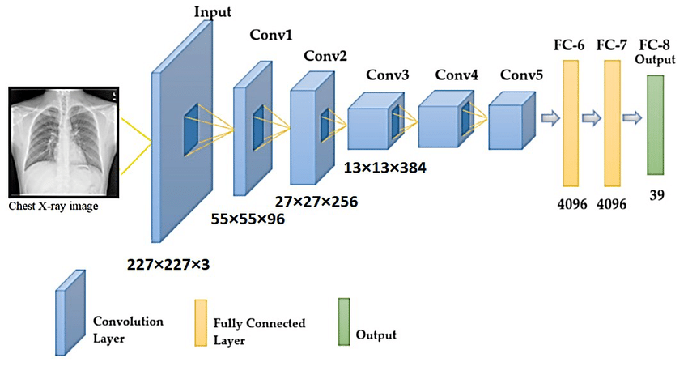
Architecture Diagram
For example see below:
Generate the architecture diagram: Check this link for the same - How to Visualize Neural Network Architectures in Python | by Angel Das | Towards Data Science

Slide 37
Algorithm Procedure
Explain how the deep learning architecture works ?
Explain the architecture in detail: Explanation must have step by step calculations for a given input (can be shown in diagram representation along with explanation)

Slide 38
Experimental Set up
Table.No: Architecture Hyper parameter settings
S.No | Name of the Parameter | Purpose | Possible Value | Unit
1 | No. of epochs | It denotes a complete iteration through the entire training dataset in one cycle for training | 100 | -

Slide 39
Performance Measures
Table.No: Performance measures
S.No | Measure/Metric | Unit | Purpose
1 | Accuracy
2 | Precision
3 | Recall
4 | Sensitivity
5 | Specificity
Note: Provide graphs and its rationale

Slide 40
Split Ratio of the Dataset
Training set :
Test Set:
Validation set: if considered.
For example, if a dataset has 1000 images, of which 800 belong to the category: “dog” and 200 belong to the category: “cat,” random sampling is employed to split the data into training and validation sets in an 80%-20% ratio (respectively), it might so happen that the training set consists only dog images, while the validation set consists of only cat images.

Slide 41
Explainable AI
Algorithm Name | Student contributed
Explain the architecture chosen and discuss how interpretation can be done.

Slide 42
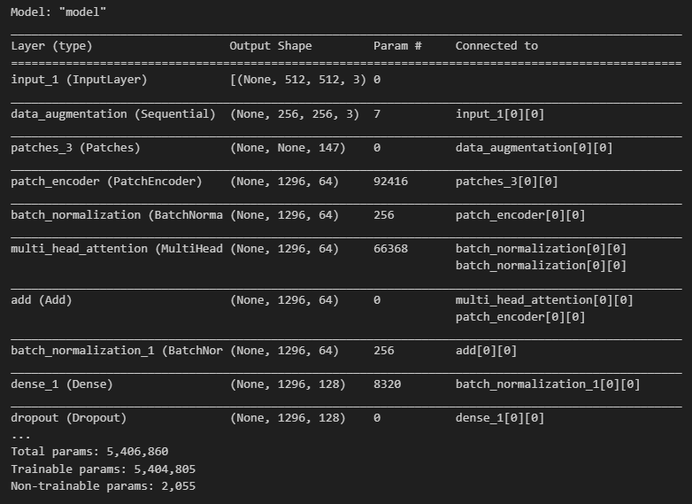
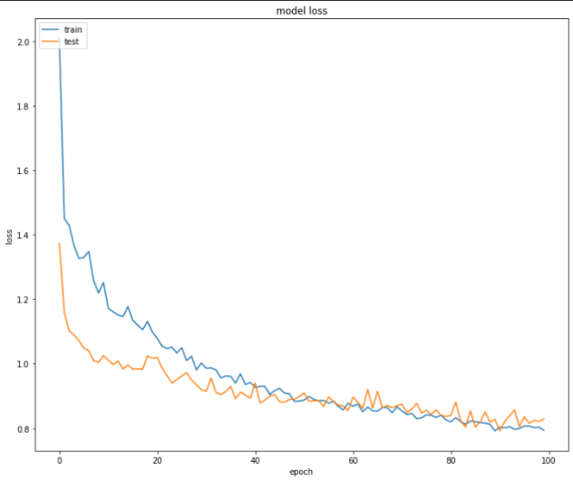
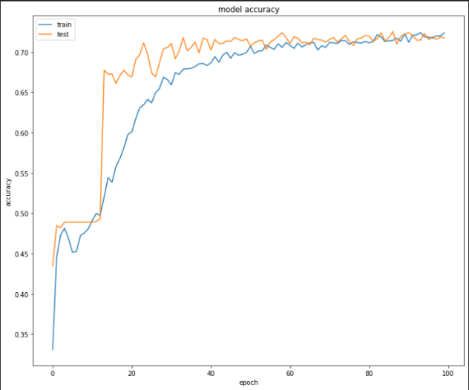
For example
Model
S.No | Epochs | Training Accuracy | Training Loss | Validation Accuracy | Validation Loss | AUC
1 | 1-20 | 0.58 | 1.11 | 0.47 | 1.01 | 0.87
2 | 20-40 | 0.60 | 0.96 | 0.51 | 0.90 | 0.89
3 | 40-60 | 0.66 | 0.87 | 0.68 | 0.89 | 0.90
4 | 60-80 | 0.71 | 0.84 | 0.70 | 0.85 | 0.915
5 | 80-100 | 0.72 | 0.81 | 0.72 | 0.82 | 0.917
Optimizer – Adam
Activation – Soft max
Loss Function – Categorical cross entropy
Epochs – 100
Regularization – Drop out
Precision: 0.3357
Recall: 0.4144
F1 Score: 0.3671

Slide 43
Conclusion and Future Enhancement

Slide 44

References
Note: Use IEEE citation format generator to provide thee references in IEEE format. Necessary info for getting the format is DOI.
Citations must be given for each reference. (Can refer the application named Litmaps for a graphical view. Follow this link Litmaps | Your Literature Review Assistant). In the next slide sample graph from Litmaps is shown for the datasets.

Slide 45
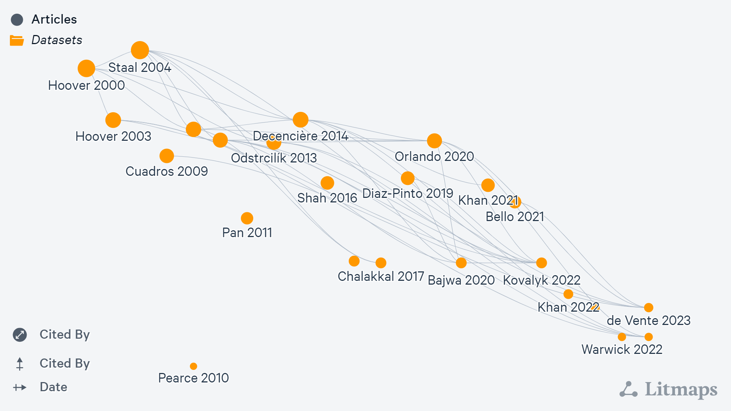

Slide 46
Identified metrics of the journal/Conference for all the references considered
S.No | Title of the paper | Citation count | Type of Publication(Conference/Journal) | Name of the Journal / Conference | Cite score | Impact Factor | Quartile | Indexed(Scopus/Web of Science/ PubMed/Google Scholar)

